Slide 1
Power Electronics
By: Zhang Liwei（张立伟）
E-mail: lwzhang@bjtu.edu.cn
Tel.: 51682335

Slide 2
Gate Driver & Snubber circuit design

Slide 3
Key points of this topic
(1) Why we need snubber in practical application?
(2) Diode snubber;
(3) Overvoltage snubber for MOSFET and IGBT;
(4) Over-current protect of power devices.
(5)Gate driver design for MOSFET and IGBT.
(6) Impact of driving resistance to the transition curves of voltage and current;
Ref. Chapter 18: Protection of Devices and Circuits
Chapter 17：Gate Drive Circuits

Slide 4
1. Why we need snubber?
(1) di/dt or dv/dt limits
(2) EMI
Issues in application
(3) Overshoots
(4) Safe Operating Area (SOA)
(1) di/dt or dv/dt limits
Also, some devices have di/dt or dv/dt limits (esp. thyristor type devices). Higher dv/dt may cause latchup for IGBT and MOSFET
(2)EMI
High di/dt, dv/dt lead to EMI, affects control circuits. (dv/di→ capacitive coupling, di/dt→ inductive coupling)

Slide 5
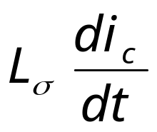
(3) Overshoots
L₁
L₂
I_{o}
I_{o}
V_{d}
i_{c}
+
V_{d}
v_{sw}
i_{c}
S_{w}
+
L₃
-
S_{w}
v_{sw}
-
(b)Real circuit
(a)Ideal circuit
L₁, L₂, L₃ are stray inductor
L_{σ}=L₁+L₂+L₃
v_{SW}
V_{d}

Slide 6
(4) Safe Operating Area (SOA)
PE devices have limitations on simultaneous voltage & current applied instantaneously (IGBT, MOSET, etc.)
i_{sw}
Turn-off
i_{L}
SOA of MOSFET & IGBT
SOA
v_{sw}
Device can operate at I_{L} and can operate at V_{in}, but not at same time
V_{in}
i_{sw}
v_{sw}
V_{in}

Slide 7
2. Snubber circuit
(1) Snubber’s Function is to protect semiconductor devices by
(a) Limiting device over voltages during turn-off transients.
(b) Limiting the rate-of-rise of voltages (dv/dt) across the semiconductor device at device turn-off .
(c) Limiting device di/dt through the semiconductor device during turn-on transients.
(d) Shaping the switching trajectory of the device as it turns on/off and lows the device power dissipation
(2) Basic snubber circuit
(a) R-C snubber,(b)R-C-D snubber, (c) L snubber

Slide 8
(a) R-C snubber（ Unpolarized ）
Generally, it is used to protect Diodes and Thyristors by limiting the peak transient voltage across the devices and dv/dt during reverse recovery time.
+
L
σ
R_{s}
v_{an}
L_{σ}
1
3
5
I_{o}
-
+
v_{bn}
L_{σ}
A
V_{d}
-
+
D_{f}
C_{s}
B
i_{d}
-
v_{cn}
+
L_{σ}
C
-
S_{w}
C_{s}
snubber
4
6
2
R_{s}
R-C snubber for diode
R-C snubber for thyristor

Slide 9


di_{Df}
V_{d}
=
I
dt
L
σ
o
t
Introducing a R_{s}-C_{s} snubber circuit
i_{Df}(t)
I_{rr}
v_{Df}(t)
t
+
L
σ
V_{d}
R_{s}
I_{o}
Diode voltage without snubber
di_{L}
V_{d}
L
σ
D_{f}
C_{s}
σ
dt
-
S_{w}
snubber
Notes for Rs-Cs parameters in R-C snubber design:
(1)Generally, both Rs and Cs of diode snubber can be chosen as base value of them respectively.
(2) However, snubber is not necessary in many application due to negligible energy in Lσ because of super layout and excellent characteristics of the employed diodes

Slide 10
overvoltage protection R_{s}-C_{s} snubber circuit
The roles of elements
C_{s}的作用是限制D_{f}上的dv/dt和关断过电压；
R_{s}的作用是限制C_{s}的放电电流。
L
+
σ
R_{s}
I_{o}
V_{d}
D_{f}
C_{s}
-
S_{w}
snubber

Slide 11
(b) RCD snubbers
Used as turn-off snubbers to shape the turn-off switching trajectory of controlled switches.
Used as overvoltage snubbers to clamp voltages applied to controlled switches to safe values
Limit dv/dt during device turn-off
Used for switching device MOSFET, IGBT, BJT, IGCT etc.
i_{Df}
D_{f}
I_{o}
L
σ
+
+
R_{ov}
D_{f}
I_{o}
V_{d}
D_{s}
i_{Cs}
D_{ov}
V_{d}
R_{s}
S_{w}
S_{w}
C_{s}
-
-
C_{ov}
Turn-off snubbers to limit dv/dt
Overvoltage snubbers

Slide 12
RCD snubber 各元件的作用
C_{s}的作用是限制上S_{w}的dv/dt和限制关断过电压；
R_{s}的作用是当S_{w}开通时泄放C_{s}上的能量，并限制放电电流；
D_{s}的作用是当S_{w}关断时使R_{s}短路，更好发挥限制上S_{w}的dv/dt和限制关断过电压的作用。
Turn-off Snubber
i_{Df}
D_{f}
I_{o}
+
V_{d}
D_{s}
S_{w}
R_{s}
-
i_{Cs}
C_{s}

Slide 13
The roles of elements
C_{ov}的作用是限制S_{w}上的dv/dt和限制关断过电压；
R_{ov}的作用泄放C_{ov}上的能量，并限制放电电流；
D_{ov}的作用是提供C_{ov}充电回路，更好发挥限制S_{w}的dv/dt和限制关断过电压的作用。
Overvoltage Snubber
L
σ
+
R_{ov}
D_{f}
I_{o}
D_{ov}
V_{d}
S_{w}
-
C_{ov}

Slide 14
(c) Polarized L-R snubbers
Used as turn-on snubbers to shape the turn-on switching trajectory of controlled switches.
Limit di/dt during device turn-on
Especially for slow switching devices, Such as Thyristor, GTO, IGCT
+
+
D_{f}
I_{o}
L_{s}
R_{Ls}
Snubber
circuit
I_{o}
D_{Ls}
R_{Ls}
V_{d}
L_{s}
V_{d}
D_{Ls}
D_{f}
-
S_{w}
-
S_{w}
Limit di/dt
Turn-on snubber

Slide 15
3. Gate Drive Circuits
(1) What function does gate drive circuit have?
a) Provide interface between the control circuit and power switch
It amplifies control signals to levels required to drive power switch
Provides electrical isolation between power switch and logic level signal control circuits when it is needed
MCU
TTL/CMOS
Control signal
Gate drive
On: +15V
Off: -9V
MOSFET
IGBT etc.
When electrical isolation is necessary?

Slide 16
b) Waveshaping output of the drive circuit to improve the power switch turn-on or turn-off performance.
Minimize turn-on and turn-off time to reduce switching loss.
Provide adequate drive power to keep power switch in on-state
Provide reverse bias to ensure that power switch remains off and is not prone to be triggered by transient noise.
c) Provides overcurrent or overvoltage protections, blanking time for complementary（互补） devices.

Slide 17
(2) How to design gate drive circuit
Key features for gate drive circuit design consideration:
(1) Drive circuit topologies
Output signal polarity.
(2) Output peak current capability
Larger Ig speed-up turn-on and turn-off process.
(3) Protection for power switch
0
t
Unipolar
0
t
Bipolar
Overcurrents or short circuit protection
Blanking time for complementary devices
(4)Have minimize stray inductance across gate drive wire and be immune to switching noise.

Slide 18
Example1. Bipolar Gate drive circuit for IGBT and MOSFET
Operating principle of the gate drive circuit shown in Fig.28-5(a).
V_{BB+}
Anti-saturation diode D_{as} keeps Q_{sw} slightly out of saturation.
V_{AE} = V_{BE(on)} + V_{D1} = V_{CE(on)} + V_{Das}
(28-6)
V_{CE(on)} = V_{BE(on)} > V_{CE(sat)} because V_{D1} = V_{Das} (28-7)
D₂ provides path for negative base current at Q_{sw} turn-off.
R_{B}
T_{B+}
D_{as}
D₁
A
Q_{sw}
T_{B-}
D₂
E
V_{BB-}
Fig. 28-5 (a)

Slide 19
Example2. Bipolar Gate drive circuit for IGBT and MOSFET
C_{on}----speed-up capacitor to speed up the turn-on sequence.
V_{BB+}
V_{d}
Comparator
C_{on}
R_{B}
D_{f}
I_{o}
R₁
C_{BB+}
V_{control}
T_{B+}
+
Q_{sw}
V_{reference}
-
T_{B-}
C_{BB-}
V_{BB-}
Transient overdrive provided via C_{on} for faster turn-on of switch
Fig.28-4(a)

Slide 20
Example3. Bipolar Gate drive circuit for IGBT and MOSFET
Back porch
current
V_{BB+}
Front porch current
Front porch
current
R_{B1}
R_{B2}
Gate/base current
Back porch current
Control
T_{B+}
i_{B}
Q_{sw}
T_{B-}
t
V_{BB-}
Front porch, back porch gate/base currents at turn-on
Faster turn-on without putting device deeply into on-state where turn-off delay time will be substantially increased.
Applicable to BJTs, MOSFETs, IGBTs, and GTOs.

Slide 21
Example4. Unipolar Gate Drive Circuit
Unipolar drive circuits are suitable for converters with a single-switch
V_{GG}
V_{d}
(a) Simple gate drive circuit
Circuit operation
V_{control}>V_{reference}: comparator output high and Q_{sw} on.
V_{control}<V_{reference}: comparator output low and Q_{sw} off.
I_{o}
Comparator
R₁
R₂
V_{control}
Q_{sw}
-
V_{reference}
+
Fig. 28-2 Simple MOSFET gate drive circuit for low-speed and low-switching-frequency application
Large R₁ → low losses, but large R₁→R₂↑ →slow-down the MOSFET turn-on speed.

Slide 22
(b) Totem-pole gate drive circuit
V_{GG}
V_{d}
Circuit operation
V_{control}>V_{reference},comparator outputs high putting Q_{npn} on and thus Q_{sw} on.
V_{control}<V_{reference}, comparator outputs low putting Q_{pnp} on and thus Q_{sw} off.
I_{o}
Comparator
R₁
R_{G}
V_{control}
+
Q_{sw}
V_{reference}
-
Fig. 28-3(a) Discrete totem-pole gate drive circuit
Since no steady-state current flows through R_{G}, R_{G} can be much smaller in value, which results in faster turn-on and turn-off times.

Slide 23
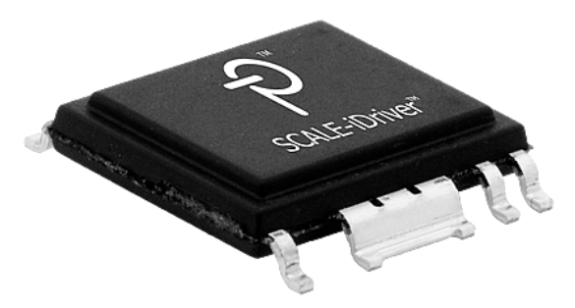
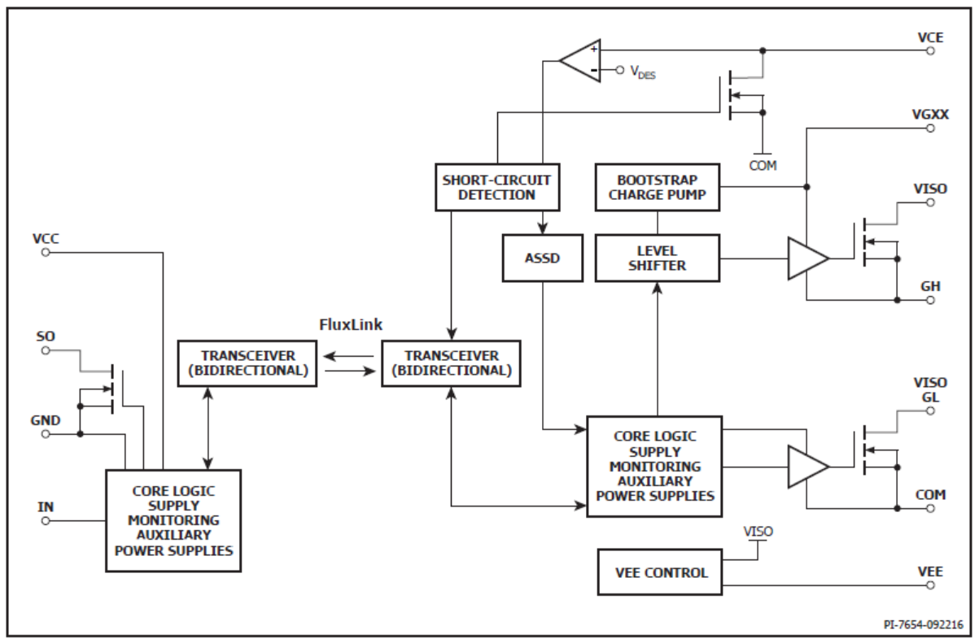
Example 5. Gate drive designed with integrated circuit or drive core
(a)Photo and block diagram of PI SCALE-iDriver

Slide 24
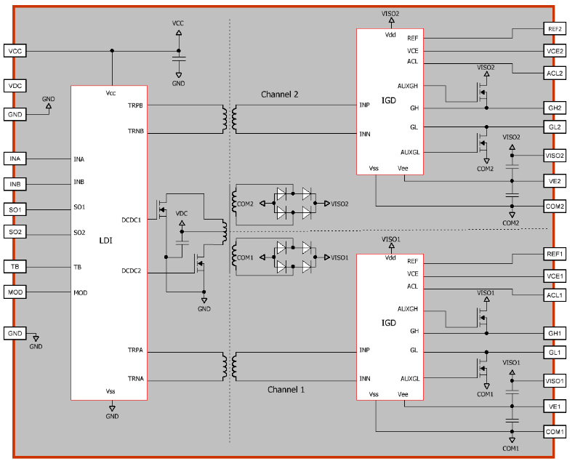
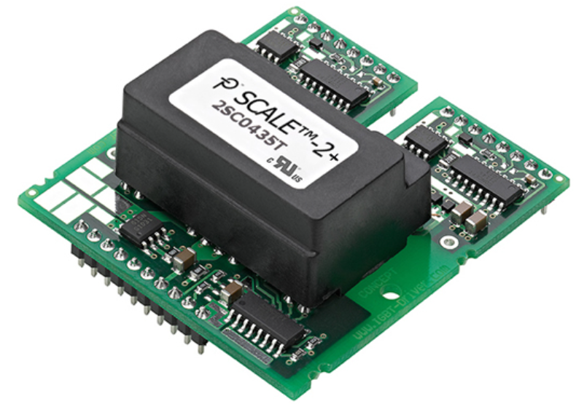
Photo of driver core
Block diagram of driver core
(b) Photo and block diagram of PI Driver core

Slide 25
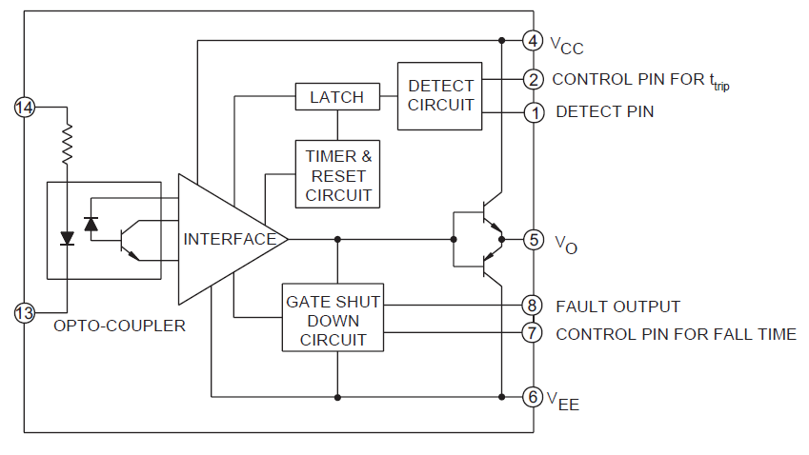
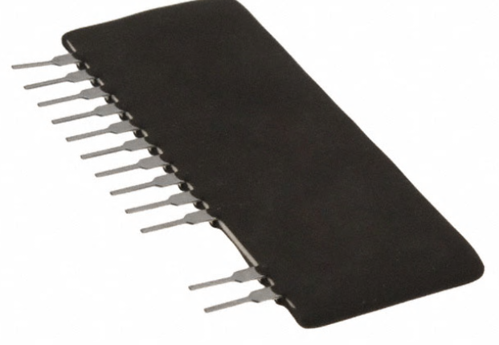
(b) Photo and block diagram of M57962 Driver core

Slide 26
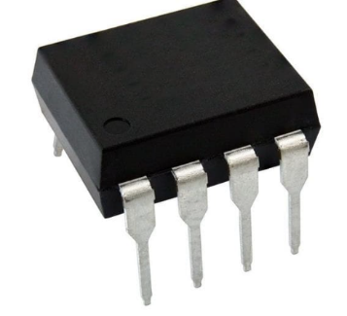
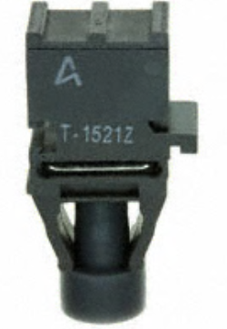
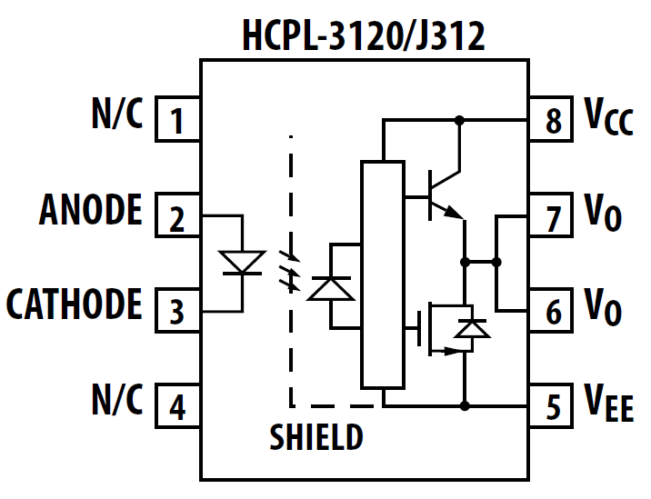
(3) Electrical Isolation ways
Opto-coupler (optical coupling)
Fiber optics (optical coupling)
Light- emitting diode
V_{BB+}
Isolated dc supply
Signal from control logic
Fiber optics
Input to remainder of isolated drive circuit
Control logic ground
Power switch reference node (BJT emitter, MOSFET source)
Photo-transistor
Opto-coupler
Fig. 28-8
A positive signal from the control logic cause LED to emit light. The light falling on the base region of photo transistor and causes the photo transistor to turn on.

Slide 27
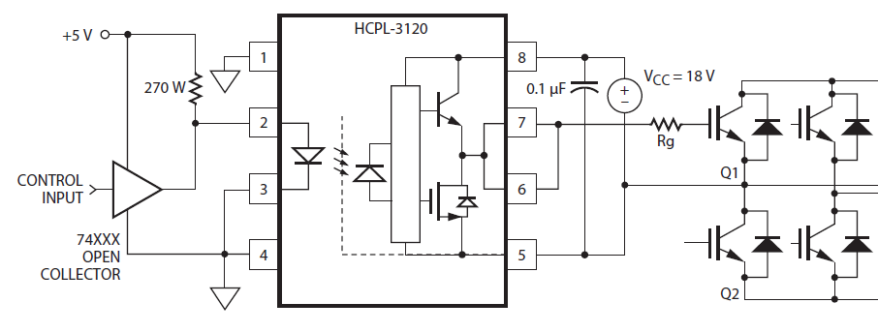
Example 1. Gate drive with Opto-coupler isolation

Slide 28
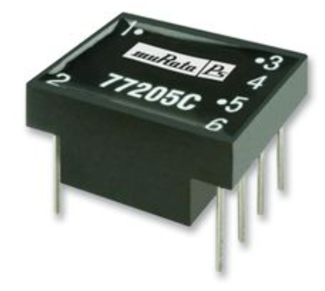
(b) Inductive coupling
I. Pulse transformer coupling
Pulse transformer
Input to remainder of isolated drive circuit
Logic level control circuits
Power switch reference node (BJT emitter, MOSFET source)
Logic ground
Fig. 28-9(a)
Applicable for high switching frequency (several tens of kHz or more) applications.

Slide 29
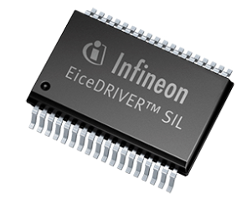
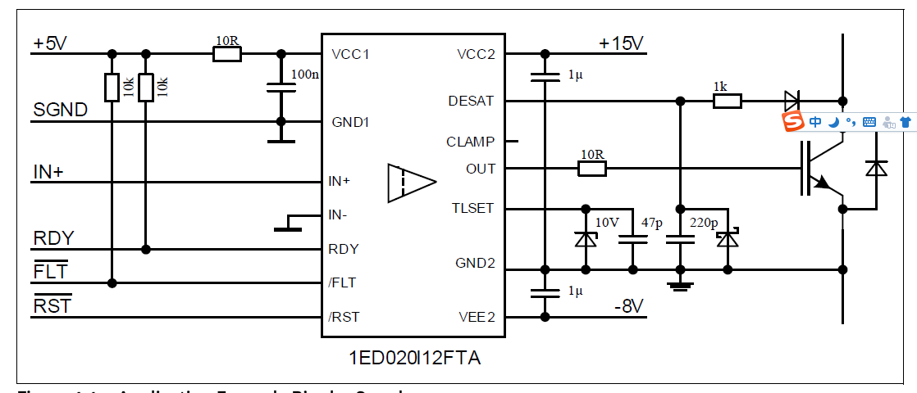
II . Coreless transformer
Photo and diagram of Infineon EiceDriver 1ED020I12FTA

Slide 30
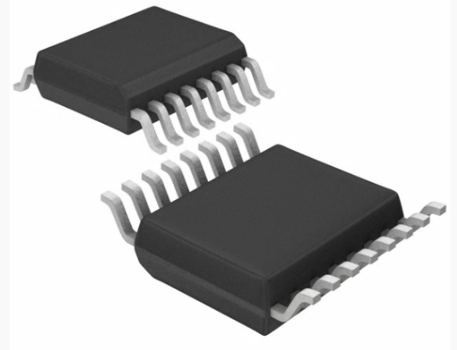
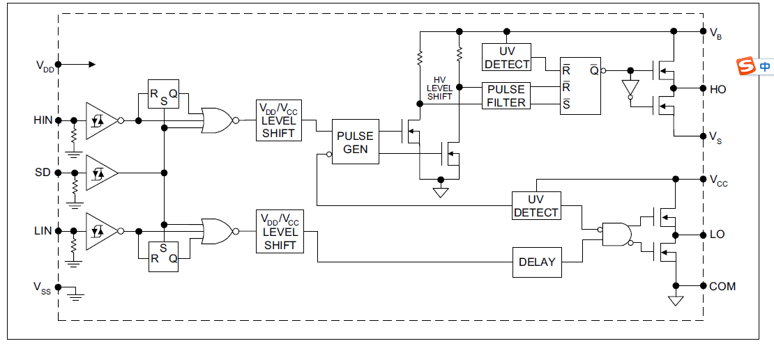
(c) Level shifter (monolithic coupling)
电平移位器(单片耦合器)
Example. IR2110 gate drive chip
IR2110
SI823

Slide 31
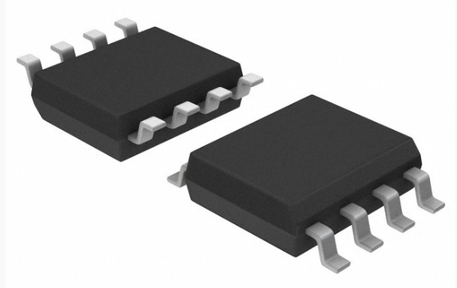
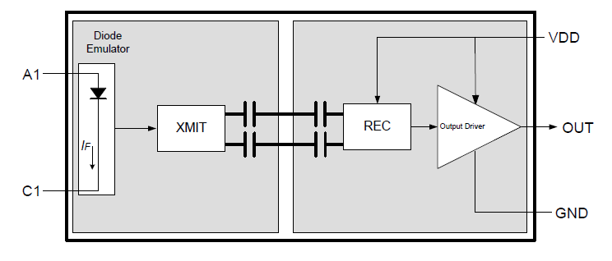
(d)Capacitive coupler (capacitive coupling)
Example: Si8261 gate drive chip

Slide 32
(4) Protection in Gate Drive Circuits
Power devices cannot be protected against the overcurrent by fuses because they cannot act fast enough.
Normally way of providing protection is to monitor collector-emitter saturation voltage V_{CE} of a BJT , IGBT or V_{DS} of a MOSFET.

Slide 33
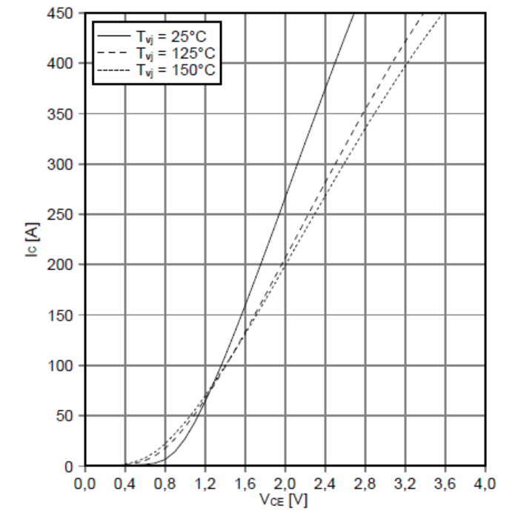
(a) Short circuit Protection With Drive Circuits
V_{BB+}
R₁
R_{B}
R_{p}
V_{d}
C
D_{p}
+
Overcurrent protection
IGBT
PWM
Vce
-
V_{BB-}
Fig. 28-23 (a)
(1) Analysis
Potential at node C equals diode drop Vd+V_{CE(sat)} when IGBT is on. Overcurrent will increase V_{CE} and thus potential at node C.

Slide 34
(b) Overcurrent Protection ways
Limiting Overcurrents by limiting gate drive current
Step-down converter with short circuit at t = t_{sc}
i_{C}
i_{C}
+
D_{F}
I_{o}
I_{C,sc}
I_{B,max}
V_{d}
C_{d}
I_{C(on)max}
-
V_{d}
v_{CE}
t_{sc}
t
Fig 28-24 (a)
Fig. 28-24 (b) and (c)
Overcurrent limited to I_{C(on)max} < I_{C,sc} by keeping I_{B,max} < I_{C,sc}/β
I_{C,sc} = maximum allowable instantaneous collector current
Same approach can be used with MOSFETs and IGBTs.
Switch should be soft/slowly turned-off when overcurrent occurs, especially short circuit.

Slide 35
(5) Design Considerations
(a) V_{GE} (V_{GS}) affects on-state losses and short circuit behavior:
V_{GE+}↑→Rdson/Vce ↓，on-state loss↓, short circuit↑
Generally: V_{GE}＝15V
(b) Provide negative voltage V_{GE-} (-V_{GS}) reverse bias to turn off device
Generally: V_{GE-} =-5V/-10V
(c) Gate drive resistance R_{G}
R_{G}↓→ transition speed of switches↑, switching losses↓，and vice versa. Too small R_{G} maybe cause unexpected resonant in gate.
Generally select: R_{G}=3~30(Ω).

Slide 36
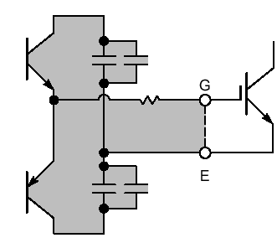
(d) Clamp of VGE and protect VGE avoid overvoltage by parallizingTVS diode between gate and source/collector
How to select the TVS break voltage?
+V_{G1}
RG
Control signal
TVS
-V_{G2}
TVS should be placed closed to IGBT

Slide 37
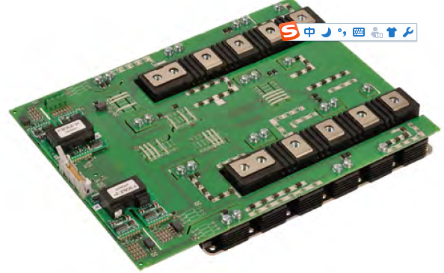
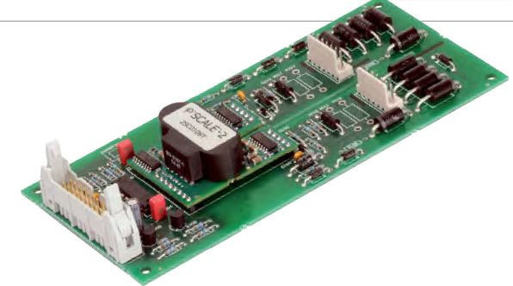
(e) Circuit /Component Layout Consideration
Minimizing stray inductance in gate drive circuit loop. Directly assemble driver board on IGBT module.
Use twist wire or shield conductor to connect gate drive board to IGBT, MOSFET etc.
Keep enough distance for electrical isolation.

Slide 38
1 Prime consideration is minimizing stray inductance
• Stray inductance in series with high-voltage side of power device Q_{sw} causes overvoltage at turn-off.
• Stray inductance in series with low-voltage side power device Q_{sw} can cause oscillations at turn-on and turn-off.
V_{d}
V_{d}
Control Signal
D_{f}
I_{o}
D_{f}
I_{o}
Control Signal
Drive Circuit
Q_{sw}
L
σ
Drive Circuit
Q_{sw}
L
σ
• One cm of unshielded conductor has about 5 nH of series inductance.
• Keep unshielded conductor lengths to an absolute minimum.

Slide 39
2 Use shielded conductors to connect drive circuit to power switch if there must be any appreciable separation (few cm or more) between them.
V_{d}
Twisted or shielded conductors
Control Signal
D_{f}
I_{o}
Drive Circuit
Q_{sw}
Fig. 28-27 (a)

Slide 40
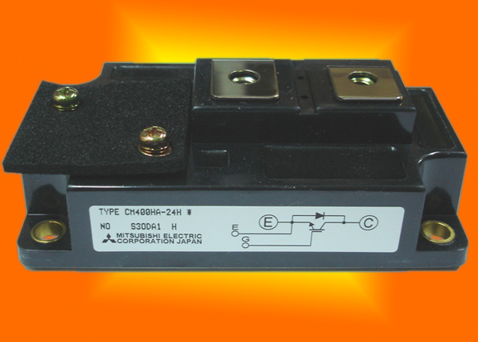
Some power devices provided with four terminals, two input terminals and two power terminals, to short emitter connection to gate drive circuit, hence to minimize stray inductance in input circuit.
C
Control terminals
G
Power terminals
E
E
Fig. 28-27 (c)

Slide 41
Questions
What are the functions of Gate/Base drive circuits?
What are the considerations in designing drive circuit?
What are the advantages and disadvantages of transformer gate isolations?
What are the advantages and disadvantages of opto-coupled gate isolations?

